Slide 1
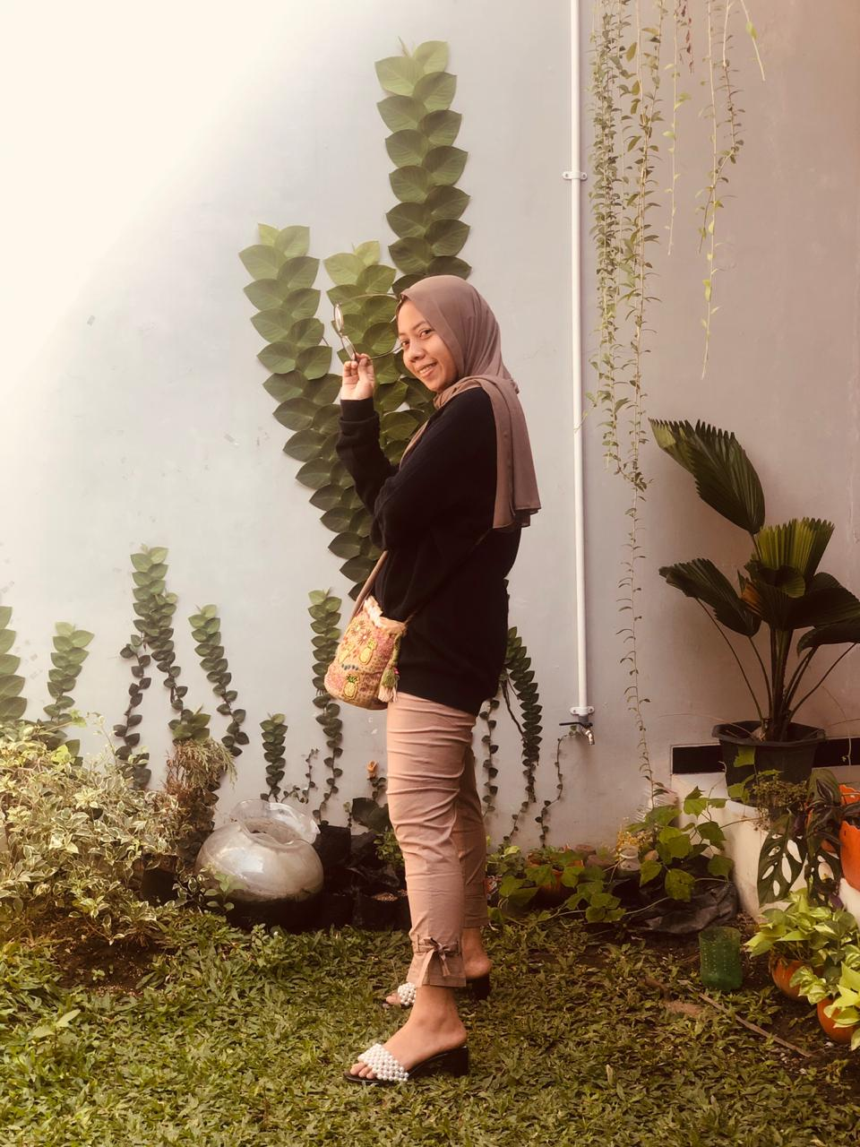
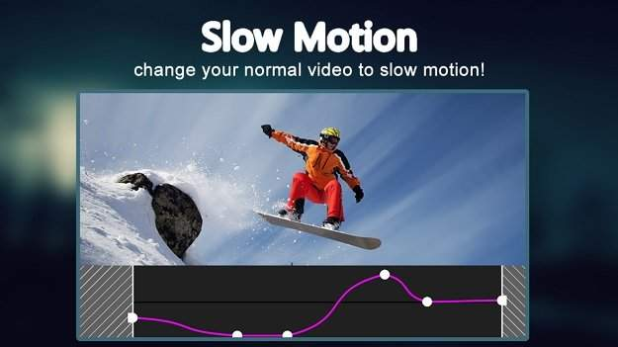
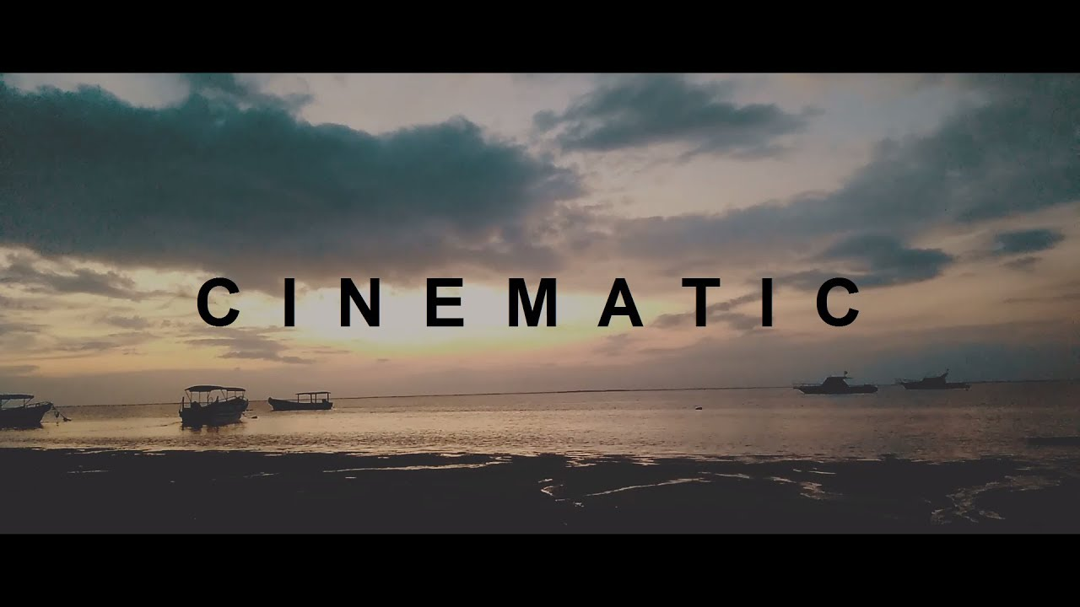

Shinta ayu lestari
“PRIMARY RESEARCH”
APPLICATION OF KINEMASTER
“Kinemaster can be improve my imagination for editing”
DEMOGRAPH
TECH
Age : 29
Location : Sidoarjo
Education : D2 (ATKP)
Job : Manager of Checker Plane’s Engine
Family : Live with her husband
INTERNET
SOCIAL NETWORK
MESSAGING
GAMES
ONLINE SHOPPING
EDITING
GOALS
FRUSTRATIONS
Editing Video
Editing Photo
Improve Editing Creation
Make a Choice of Colors
Less Lighting When Shooting
limited / prepaid filters
EDITING HABITS
FAVORITE OF EDITING
Managing of Saturation’s Photo
Managing of Filter Effect
Cutting of Scene What Don’t Need It
CINEMATIC
VIDEO
DOCUMENTARY
VIDEO
DOCUMENTARY
VIDEO

Slide 2
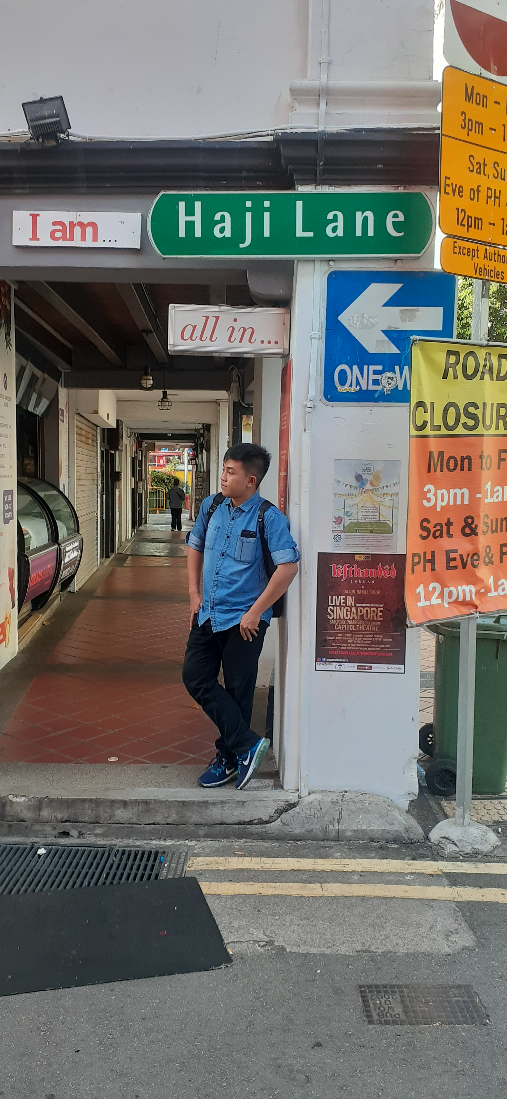



MOHAMMAD FAJ’RUL FALAAH HIDAYAT
“Imagine can be improve my creation for editing”
DEMOGRAPH
Age : 20
Location : Sidoarjo
Education : Undergoing Education Bachelor Degree
Job : Information Technology
Family : Live with My Family
TECH
INTERNET
SOCIAL NETWORK
MESSAGING
GAMES
ONLINE SHOPPING
EDITING
GOALS
FRUSTRATIONS
Editing Video
Editing Photo Motion
Improve My Skill of Editing
Less of Facility for Making a Footage
Less of Model’s
Need a Long Time
EDITING HABITS
FAVORITE OF EDITING
Managing of Filter Effect
Cutting of Scene What Don’t Need It
Making shortvideo
CINEMATIC
VIDEO
SHORT
FILM
EDUCATION
VIDEO
“PRIMARY RESEARCH”
APPLICATION OF KINEMASTER
Notes:
© Copyright Showeet.com – Free PowerPoint Templates

